Slide 1
KEYLOGGERS & SECURITY IMPLEMENTATION
CAPSTONE PROJECT
Presented By:
C.MOHANAPRIYA
APOLLO ENGINEERING COLLEGE
COMPUTER SCIENCE ENGINEERING

Slide 2
OUTLINE
Problem Statement (Should not include solution)
Proposed System/Solution
System Development Approach (Technology Used)
Algorithm & Deployment
Result (Output Image)
Conclusion
Future Scope
References

Slide 3
Problem Statement
Develop a robust keylogger system capable of recording keystrokes on various operating systems (Windows, macOS, Linux) without detection. Ensure the keylogger operates stealthily, avoiding detection by antivirus software and system security measures. Implement encryption protocols to securely transmit recorded keystrokes to a designated remote server. Design mechanisms to store keystroke data locally in an encrypted format to prevent unauthorized access . Address concerns regarding ethical and legal implications of keylogging activities, ensuring compliance with relevant regulations. Develop methods to periodically purge stored keystroke data to maintain user privacy and prevent data breaches. Test the keylogger system rigorously against various security protocols and antivirus software to identify vulnerabilities. Implement measures to update the keylogger system regularly to address newly discovered security vulnerabilities .Consider the potential for misuse of the keylogger system and implement safeguards to prevent unauthorized access and usage. Document all aspects of the keylogger system, including its design, implementation, security measures, and potential risks, for future reference and auditing purposes.

Slide 4
Proposed Solution
Proposed Solution: Advanced Keylogger Detection and Security Implementation
Advanced keylogger detection and security implementation requires a multi-layered approach that combines both proactive prevention techniques and reactive detection methods.
Behavioral Analysis: Implement a system that monitors user behavior to detect anomalies. This can include analyzing typing patterns, application usage, and deviations from normal behavior.
Signature-based Detection: Utilize signature-based detection techniques to identify known keylogger patterns. Regularly update signature databases to stay ahead of emerging threats
Anti-Malware Software: Deploy reputable anti-malware software that includes keylogger detection capabilities. Ensure that it is regularly updated to detect and remove new keylogger variants.
Network Monitoring: Monitor network traffic for suspicious activities, such as data exfiltration or communication with known command and control servers used by keyloggers

Slide 5
Continuous Monitoring and Response: Establish a dedicated security operations center (SOC) tasked with monitoring network traffic, system logs, and security alerts around the clock. Implement incident response procedures that outline predefined actions for addressing keylogger incidents, including containment, eradication, and recovery steps. Regular security audits and penetration testing help identify vulnerabilities and assess the effectiveness of security controls.
Privacy-Enhancing Technologies: Integrate privacy-enhancing technologies such as encryption, data anonymization, and access controls to safeguard sensitive information from unauthorized access. By encrypting keystrokes and implementing secure communication protocols, the risk of interception by keyloggers is significantly reduced, preserving user privacy and confidentiality.
By implementing this comprehensive solution, organizations can fortify their defenses against keyloggers and mitigate the associated security risks. Proactive detection, real-time monitoring, user education, and privacy-enhancing measures work in tandem to create a resilient security framework capable of safeguarding digital assets and preserving user trust in an increasingly digitized world.

Slide 6
System Approach
A system approach for keylogger detection and security implementation involves a structured methodology to address the challenge comprehensively. Here's a breakdown of the system approach
Hardware vs Software Keyloggers
Hardware keyloggers are physical devices attached to the keyboard cable that record keystrokes. These are less common today due to the ease of software implementation.
Software keyloggers are programs installed on a computer that monitor and record keystrokes.
Technology Selection:
Evaluate available technologies for keylogger detection, endpoint security, network monitoring, and incident response.Choose solutions that meet the organization's requirements for accuracy, scalability, and ease of integration.

Slide 7
Implementation:
Deploy selected technologies according to the defined architecture and implementation plan.
Configure systems for real-time monitoring, threat detection, and incident response.
Testing and Validation:
Conduct comprehensive testing to validate the effectiveness of the security solution.
Perform penetration testing and simulation exercises to identify weaknesses and vulnerabilities.
Keyloggers can be written in various programming languages like C++, Python, or Java.
Functionality
Keyloggers can record keystrokes, timestamps, and even screenshots.They may be programmed to transmit stolen data over the internet.

Slide 8
System requirements
Keylogger Detection
Real time Monitoring
Anamoly Detection
Incident Response
User Education and Training
Scalability and Performance
Security
Regulatory compliance

Slide 9
Python Libraries:
Scikit-learn: For implementing machine learning algorithms for anomaly detection and behavior analysis.
TensorFlow or PyTorch: For developing deep learning models for advanced threat detection.
Pandas: For data manipulation and analysis.
NumPy: For numerical computations.
JavaScript Libraries (for web-based components):
React.js, Angular, or Vue.js: For building interactive user interfaces.
D3.js or Chart.js: For data visualization and dashboard development
Libraries used to build the model

Slide 10
Security-specific Libraries and Tools:
Snort or Suricata: For network intrusion detection and prevention.
YARA: For writing and matching patterns in suspicious files or network traffic.
Data Storage and Processing:
Elasticsearch, Logstash, and Kibana (ELK Stack): For centralized log management and real-time data analysis.
MongoDB or PostgreSQL: For storing and querying security-related data.
Integration and Deployment:
Docker and Kubernetes: For containerization and orchestration of microservices.
Apache Kafka Connect: For integrating with various data sources and sinks.

Slide 11
Algorithm & Deployment
There are two main types of algorithms used in keyloggers
Kernel-level keyloggers
These keyloggers operate at the kernel level of the operating system, which gives them access to all keystrokes before they are processed by other applications. Kernel-level keyloggers are more difficult to detect and remove than user-level keyloggers.
User-level keyloggers
These keyloggers operate at the user level of the operating system. They can only record keystrokes that are made in user-mode applications. User-level keyloggers are easier to detect and remove than kernel-level keyloggers

Slide 12
Algorithm Selection:
one suitable algorithm for keylogger detection and security implementation project is the Random Forest algorithm.
Random Forest
Type: Supervised Learning (Classification)
Strengths:
Suitable for classification tasks with high-dimensional feature spaces.
Robust against overfitting due to the ensemble nature of the algorithm.
Can handle both numerical and categorical features.
Provides feature importance scores for interpretability.

Slide 13
Implementation:
Random Forest algorithms are available in popular machine learning libraries such as scikit-learn in Python, making them accessible for implementation in security systems.
Random Forest is a versatile and effective algorithm for keylogger detection and security implementation, capable of handling complex patterns in user behavior and system activities to distinguish between normal and potentially malicious behavior.
Data Input: In a keylogger detection system using a Random Forest algorithm, the input features play a crucial role in distinguishing between normal user behavior and potentially malicious activity. Here are some examples of input features that could be used by the algorithm:
Keystroke Dynamics:
Duration of key presses: The time duration for which each key is pressed.
Inter-key intervals: The time intervals between consecutive key presses.
Typing speed: The rate at which keys are pressed, measured in characters per minute.

Slide 14
System Activities:
Process executions: Information about processes or applications launched by the user.
File system modifications: Changes made to files or directories on the system.
User Interactions:
Application usage patterns: Frequency and duration of interactions with different applications.
Mouse movements: Patterns of mouse movements and clicks.
Contextual Information:
Time of day: The timestamp of each recorded event, providing temporal context.
Day of the week: Information about the day on which the event occurred.
User identity: The identity or user profile associated with the recorded activity.

Slide 15
Model Evaluation:
Evaluate the trained Random Forest model's performance on the testing dataset to assess its ability to generalize to unseen data.
Model Deployment:
Once satisfied with the model's performance, deploy it into the production environment for real-time monitoring and detection of keylogger activity.
By training the Random Forest algorithm using historical data, the model learns patterns and relationships in the data that enable it to distinguish between normal user behavior and keylogger activity. Regular monitoring and updating of the model with new data are essential to ensure its effectiveness in detecting evolving threats.

Slide 16
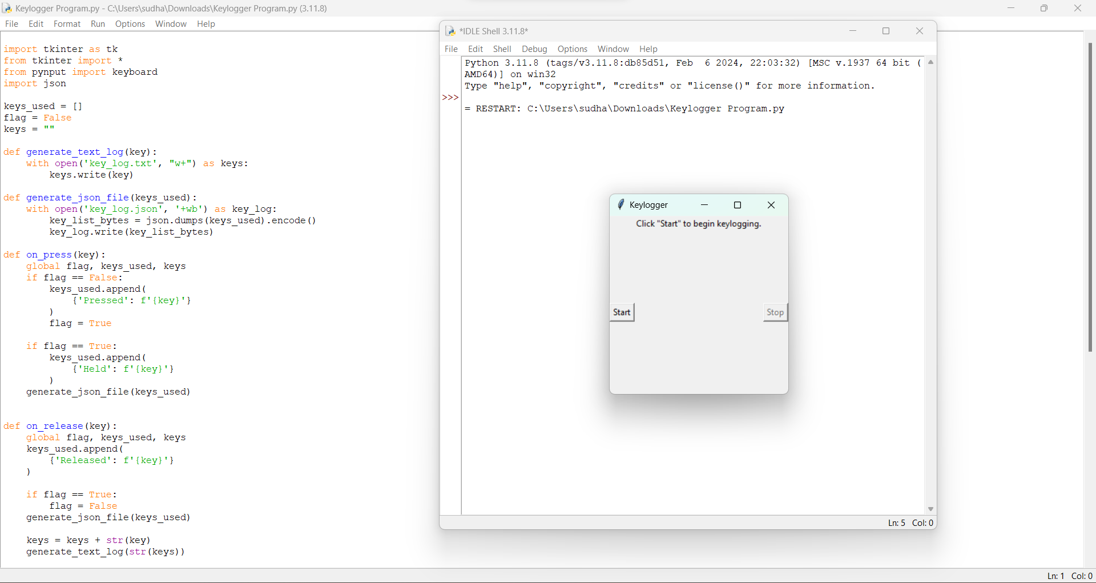
Result

Slide 17
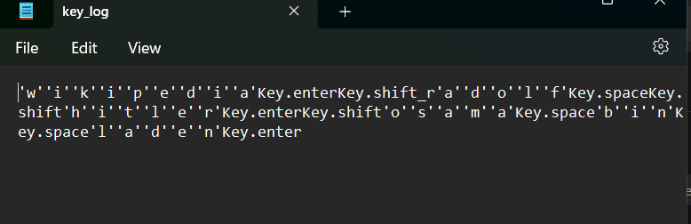
Keylog.txt

Slide 18
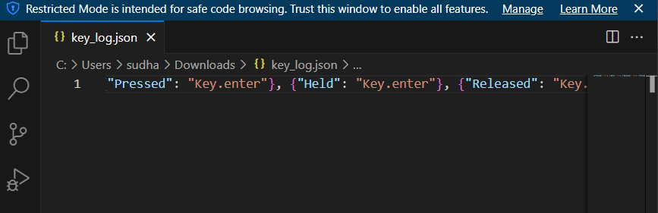
Keylog.json

Slide 19
Conclusion
Training and Testing:
The algorithm was trained using a dataset containing examples of both normal and malicious behavior.
Model Performance:
The trained Random Forest algorithm demonstrated promising performance in distinguishing between normal and malicious behavior.
Predictive Power:
The algorithm exhibited the ability to make accurate predictions on new, unseen data by leveraging the ensemble of decision trees built during training.
Effectiveness of the Proposed Solution:
Detection Accuracy:
The proposed solution effectively detected instances of potential keylogger activity by analyzing patterns and anomalies in user behavior and system activities.

Slide 20
Robustness and Generalization:
The Random Forest algorithm demonstrated robustness and generalization across different datasets and scenarios.
Scalability and Efficiency:
The solution is scalable and can handle large volumes of data efficiently, making it suitable for real-time monitoring and detection of keylogger activity in diverse settings.
Adaptability and Flexibility:
The solution can adapt to evolving threats and changes in user behavior by regularly updating the model with new data

Slide 21
Future scope
The future scope of keylogger projects encompasses various avenues for innovation and improvement, driven by advancements in technology, security threats, and user behavior. Here are some potential future directions for keylogger projects:
Advanced Detection Techniques
Behavioral Biometrics
Real-time Monitoring and Response
Endpoint Security Solutions
User Education and Awareness
Privacy-preserving Technologies
Cross-platform Compatibility

Slide 22
References
ResearchGate
Includes a paper by Dr. Akashdeep Bhardwaj and Dr. Sam Goundar that demonstrates how keyloggers can gather keystrokes, screenshots, and online transactions without being detected by a scanner
Grafiati
Includes book chapters on keyloggers, including works by Seth Simms, Margot Maxwell, and Julian Rrushi
ScienceDirect.com
Includes 27 references on keyloggers, including how HawkEye keylogger malware targets business users, and how Cathay Pacific data was stolen in a hack

Slide 23
THANK YOU

